Slide 1
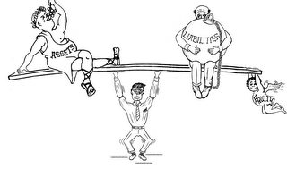
Lecture- 6 ACCOUNTING EQUATION

Slide 2
Learning Outcome
Understanding basic accounting equation
Use the accounting equation to describe the financial position of an organization, and
Use the accounting equation to analyse business transactions.

Slide 3
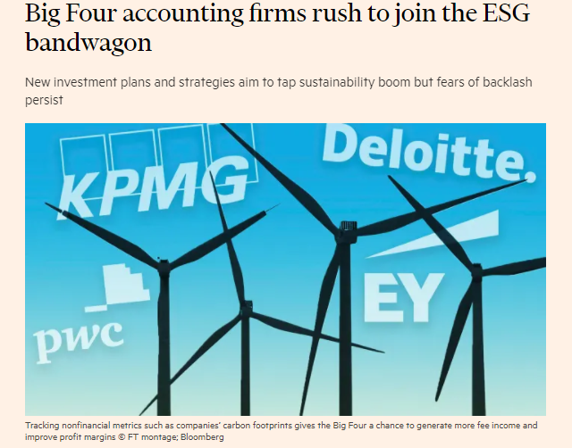
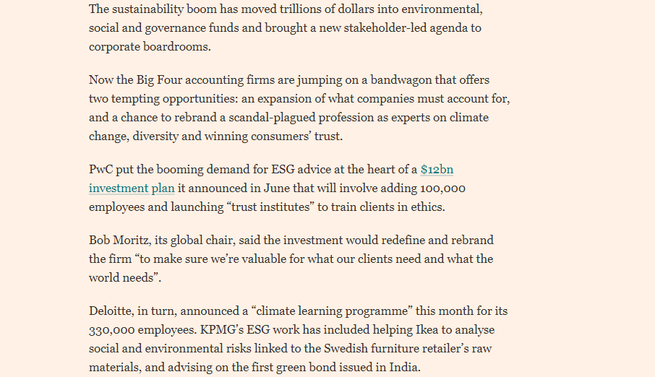

Slide 4
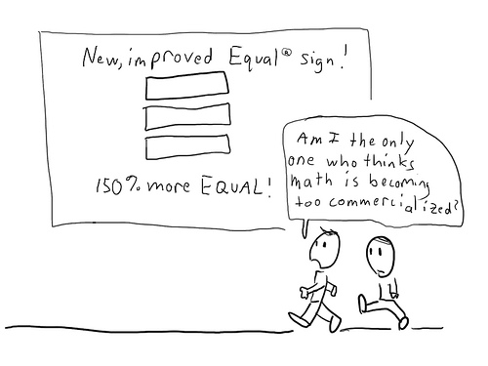
Equation
The word equation comes from the word equal. For any equation, one side always equals another.

Slide 5
The Accounting Equation
Assets = Liabilities + Owner’s Equity
The resources owned by a business

Slide 6
The Accounting Equation
Assets = Liabilities + Owner’s Equity
The rights of the creditors, which represent debts of the business

Slide 7
The Accounting Equation
Assets = Liabilities + Owner’s Equity
The rights of the owners

Slide 8
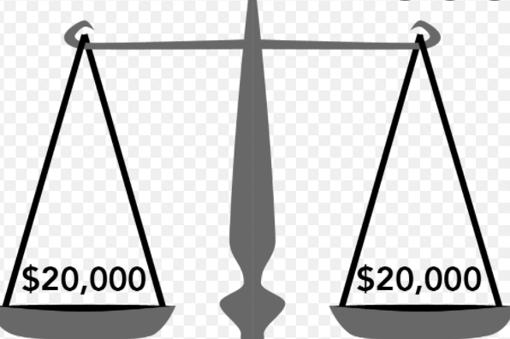
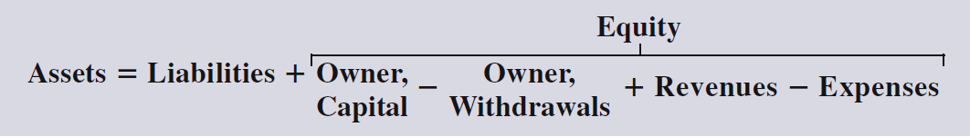
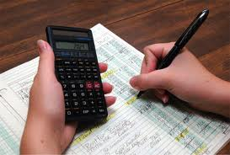
Sometimes we expand the Accounting Equation to show all the Equity components. This is called the
EXPANDED ACCOUNTING EQUATION.
This equation must ALWAYS BE IN BALANCE

Slide 9
The Accounting Equation could also apply to a personal situation. Suppose you buy a car for $5,000, borrow $4,000 from the bank, and pay the rest yourself. Here’s the result:

Slide 10



Accounting Equation
Assets
=
Liabilities
+
Equity
$5,000 = $4,000 + $1,000

Slide 11
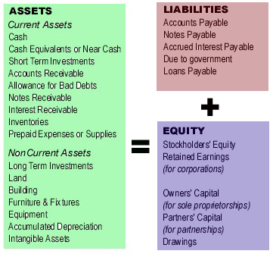

Slide 12
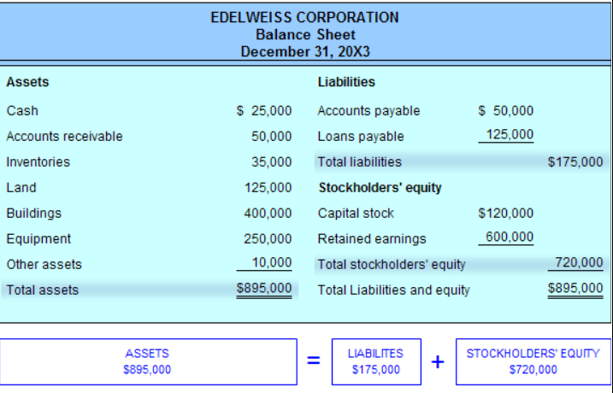

Slide 13
POLL
The basic accounting equation is assets = liabilities + ______________ ______________.
Owners Equity
True
False

Slide 14
Transactions
The accounts involved are:
(1) Cash (asset)
(2) Owner’s Equity (equity)
Owners of S. Company contributed
20,000 cash to start the business.
Notes:
21

Slide 15
Transaction Analysis
Owners of S. Company contributed
20,000 cash to start the business.
Notes:
21

Slide 16
Transaction Analysis
Purchased goods by paying 1,000 cash.
The accounts involved are:
(1) Cash (asset)
(2) Supplies (asset)
Notes:
25

Slide 17
Transaction Analysis
Purchased goods by paying 1,000 cash.
Notes:
25

Slide 18
Transaction Analysis
Purchased equipment for 15,000 cash.
Analyze the effect of above transaction
Asset Increases, Capital Increases
Asset decreases, Assets Increases
Asset Increase , Liability increases
Assets decreases ,Capital increases
Notes:
29
B

Slide 19
Transaction Analysis
Purchased equipment for 15,000 cash.
Notes:
29

Slide 20
Transaction Analysis
Purchased goods of 200 and Equipment of 1,000 on account.
The accounts involved are:
(1) Stock (asset)
(2) Equipment (asset)
(3) Accounts Payable (liability)
Notes:
30

Slide 21
Transaction Analysis
Purchased Goods of 200 and Equipment of 1,000 on account.
Notes:
30

Slide 22
Transaction Analysis
Rendered consulting services receiving 3,000 cash.
The Above transaction would impact :
Increase in Asset, Increase in Equity
Decrease in Asset , Decrease in Equity
Increase in Equity, Increase in Liability
Increase in Asset , Decrease in Asset
Notes:
32
A.

Slide 23
Transaction Analysis
Rendered consulting services receiving 3,000 cash.
Notes:
32

Slide 24
Transaction Analysis
Paid salaries to employees, £800 cash.

Slide 25
Transaction Analysis
Paid salaries to employees, Rs 800 cash.
The accounts involved are:
(1) Cash (asset)
(2) Salaries expense (equity)

Slide 26
Few Important Transactions
Any expense which is outstanding
Eg: Salary of Rs 13000 is not paid by the company and is outstanding
Wages, salary, rent, interest on the loan, etc. are examples of such expenses that may remain due at the end of the accounting year.

Slide 27
Transaction Analysis
Asset | Liabilities | Capital
No effect | ADD (+) O/S Salary = 13000 | Minus (-) O/S Salary= 13000

Slide 28
Few Important Transactions
Any Income which has been received in advance ( Pre- received Income )
Eg:- Commission of Rs 5,000 has been received in advance

Slide 29
Transaction Analysis
Asset | Liabilities | Capital
(+) Cash = Rs 5000 | (+) Commission rec in advance = Rs 5000 | No effect

Slide 30
Few Important Transactions
Any expense which has been paid in advance ( Prepaid )
Eg:- Rent of Rs 3,000 has been paid in advance

Slide 31
Transaction Analysis
Asset | Liabilities | Capital
(-) Cash = Rs 3000 (+) Prepaid Rent= Rs 3000 | No effect | No effect

Slide 32
Few Important Transactions
Accrued income i.e income which has been earned but not yet received.
Eg: Amount of commission earned but not received is ₹5000.

Slide 33
Transaction Analysis
Asset | Liabilities | Capital
(+) Accrued Income = Rs 5000 | No effect | (+) Commission = Rs 5000

Slide 34
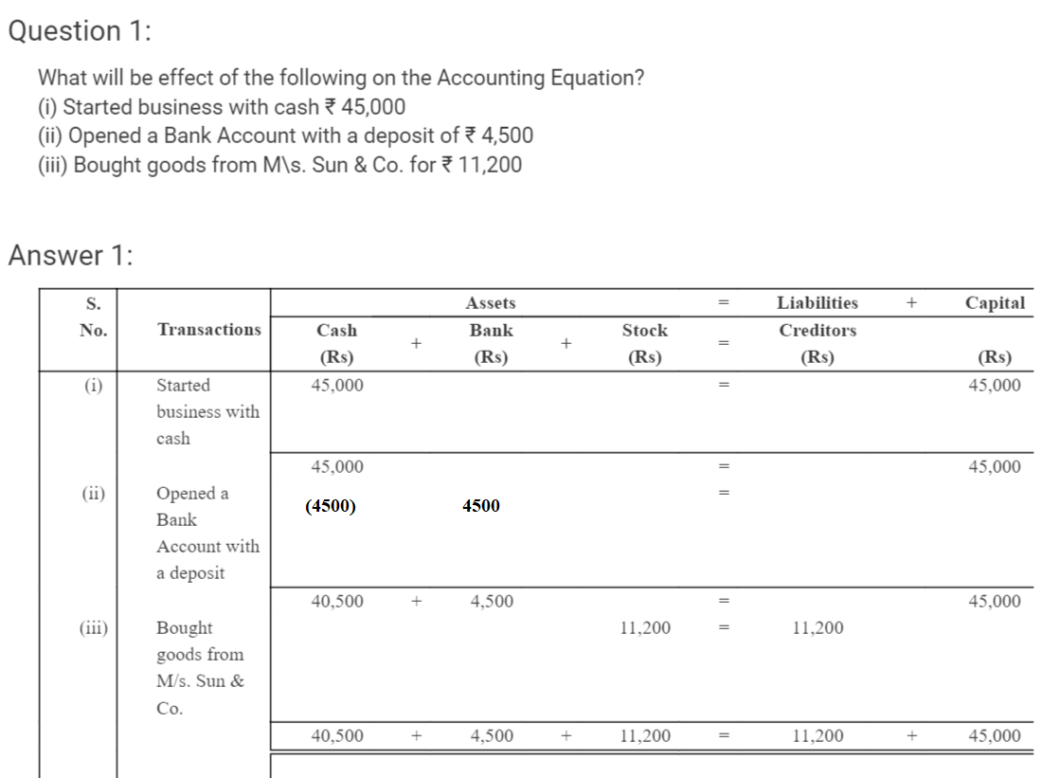

Slide 35
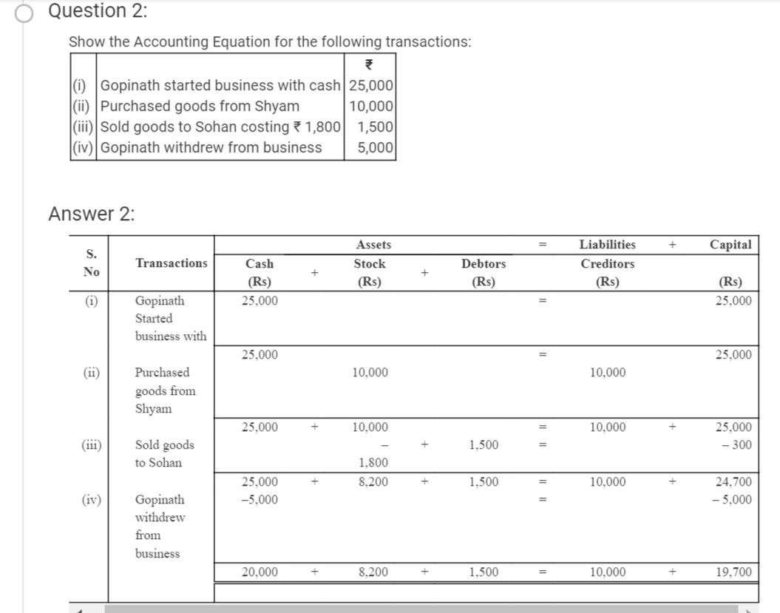

Slide 36
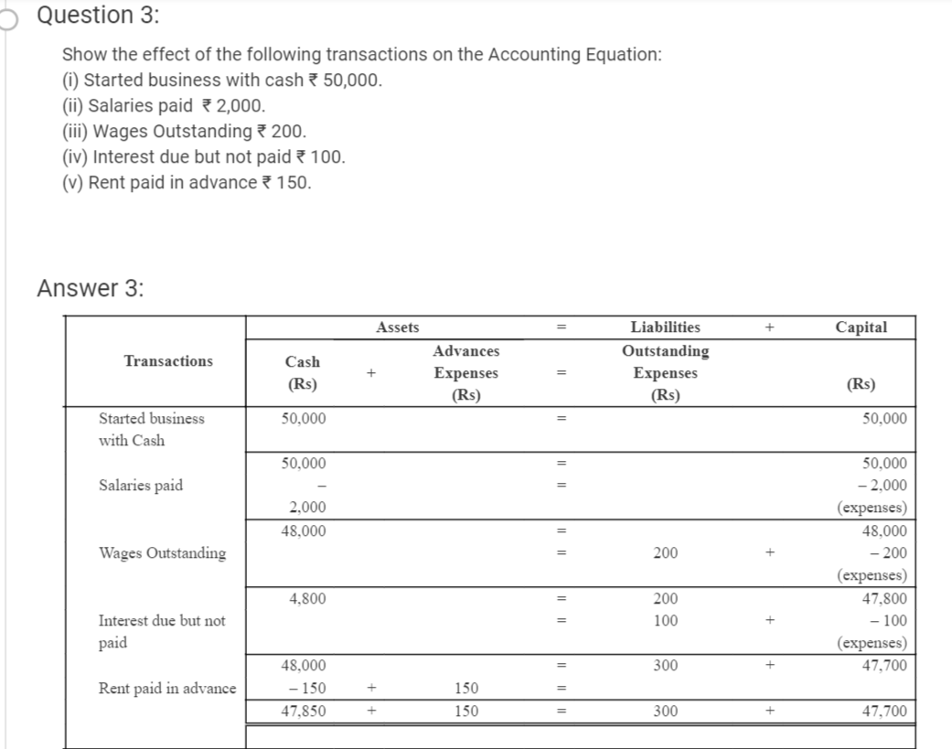

Slide 37
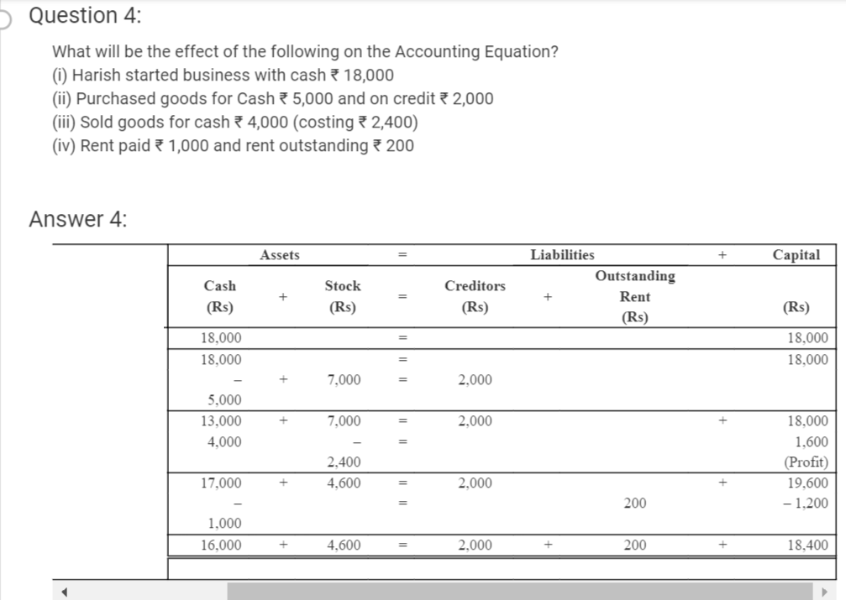

Slide 38
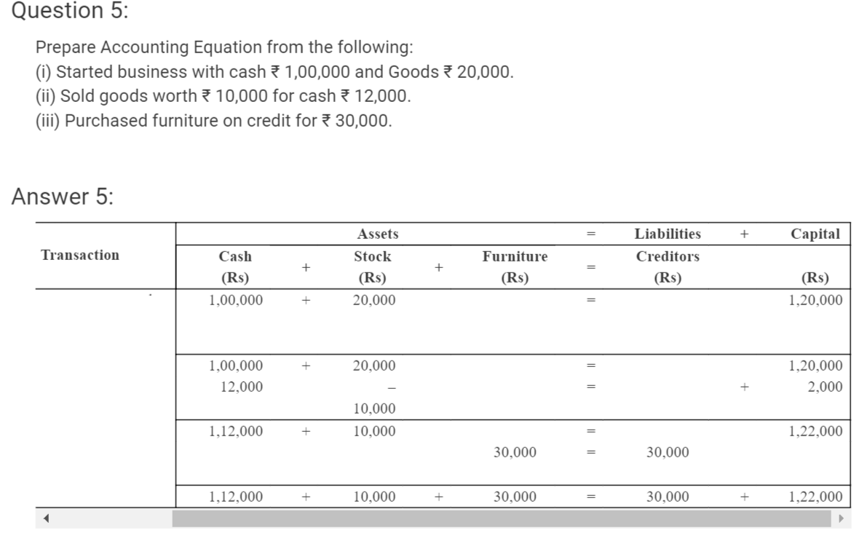

Slide 39
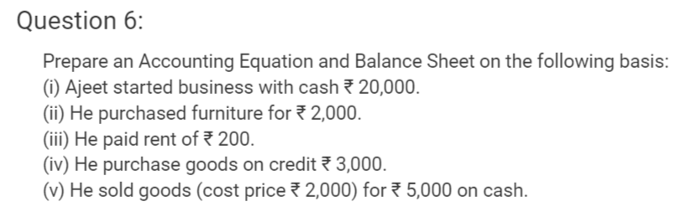
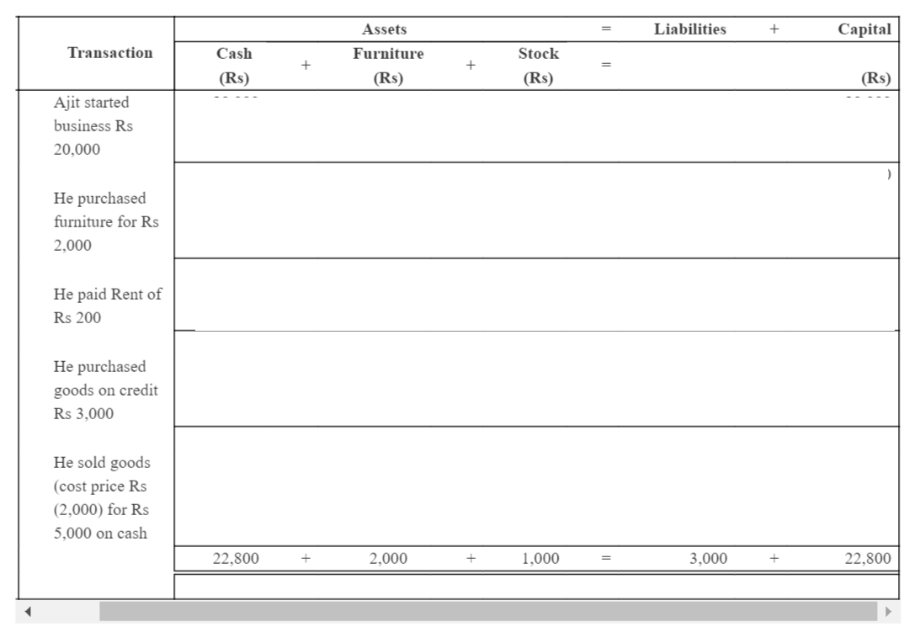

Slide 40
Question for Practice
Show the Accounting equation on the basis of following transactions in the books of Mr. Sumit:
Business started with Cash Rs. 6,00,000;
Rs. 2,80,000 deposited into Axis Bank.
Purchased stock worth Rs. 100,000 from Ram.
Paid half amount to Ram and got 10% discount.
Sold goods costing Rs. 60,000 to Geeta for Rs.80,000
Paid Rent Rs. 40,000
Goods taken by Mr. Sumit for personal use. Cost price Rs. 3,200 and selling price Rs. 4,000.
Purchased Building for Rs. 4,90,000 on credit from Deepak Ltd.
Commission received Rs. 20,000.
Wages outstanding Rs. 800.

Slide 41
Question for Practice
Give the effect of the following transactions on the accounting equation:
Commenced business with cash Rs.1 8, 00,000.
Purchased goods for cash Rs. 5,00,000.
Paid salary Rs. 50,000.
Received interest Rs. 10,000.
Sold goods for Rs. 1,50,000 on credit to Mr. A costing Rs. 1,20,000
Purchased machinery for Rs.1,00,000
Rent outstanding Rs.3,000
Purchased goods on credit from Mr. P for Rs.9,000
Drew for personal use Rs.18,000
Received cash from Mr. A Rs.14,500 in full settlement
Paid Rs. 6000 to P
Withdraw goods for personal use costing Rs. 5000

Slide 42
THANK YOU
11

